Slide 1
ROCK PAPER SCISSOR PREDICTION
Team Members
RAM CHARAN TEJA MADURI
SNEHITHA BANDA
SUHAAS SANGA
VINEELA BAISA
KEERTHAN GURRAM
MAHALAXMI KOLETI
2216103
2216108
2216114
2216119
2216121
2216124

Slide 2
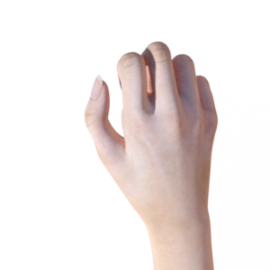
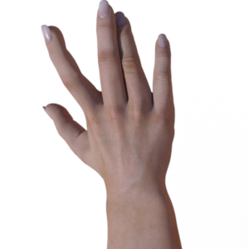
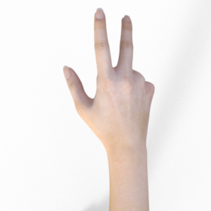
INTRODUCTION
Basically this project is about the prediction of the most popular game “ROCK-PAPER-SCISSOR” using Neural networks (CNN).
This project will predict the output such as ROCK/ PAPER/ SCISSOR with respect to the input image.
Rock Paper Scissors contains images from a variety of different hands, from different races, ages and genders, posed into Rock / Paper or Scissors and labelled as such.
.

Slide 3
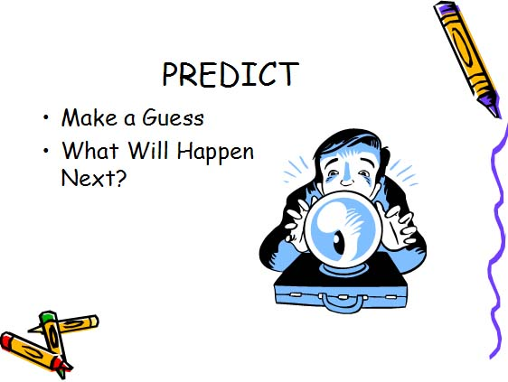
NEED OF THE PROJECT
For the ease prediction of what we actually get out from the game finally.
Accurate prediction of the images can be done by using this type of project.
This project can be used in image related less complex games.
GAME PREDICTION
WITH
IMAGE DETECTION

Slide 4
OBJECTIVES
Our main objective for this project is we should predict the given input image
with correct accuracy.
Basically our project comes under deep learning concepts.
For accurate prediction we are using neural networks concept to train our dataset in this project.
Not only predicting the images we can even design a game based on this concepts.
In this project we have to train the model on 3 different types of images like
Rock/Paper/Scissors with different angles so the it can predict the image with
perfect accuracy.

Slide 5
METHODOLOGY
ROCK_PAPER_SCISSORS.ipynb:
Loading/ Importing the dataset.
Resize all the images.
Importing required modules.
Tell the model what cost and optimization method to use.
Use the Image Data Generator to import the images from the dataset.
Training the model.
Testing the model.
Predicting Images.

Slide 6
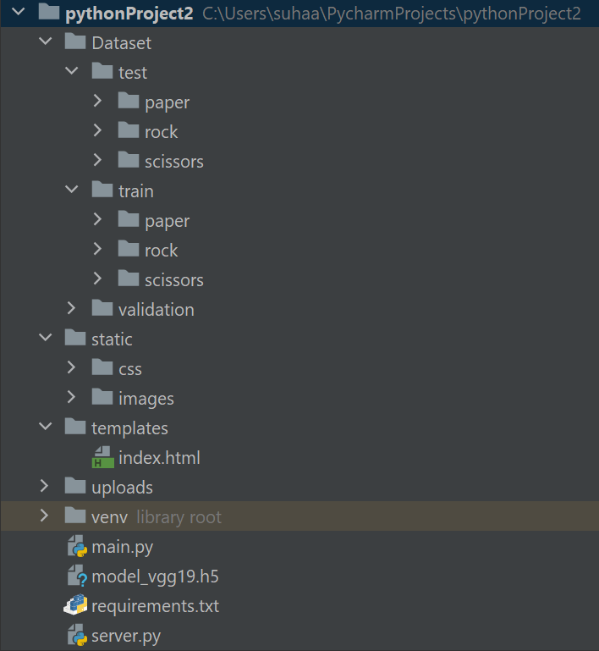
METHODOLOGY
WEB-APP:

Slide 7
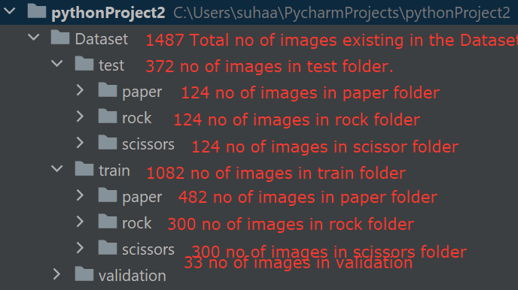
DATASET

Slide 8
CREATING THE MODEL
Importing the libraries.
> TensorFlow ( Keras )
> Numpy.
> MatPlotLib.
> Glob.
> VGG19.
From VGG19 Library, we have added the preprocessing layer to the front of VGG19. (Here, we will use the imagenet weights.
We have used GLOB Library to import all the sub folders (Output Classes).
Creating a model object.
Telling the model what cost and optimization method to use.
Using the Image data generator to import the images from the dataset.
We need to provide the same target size as initialized for the image size.
Fitting the model.
Plotting the loss and accuracy graphs.
Saving the model as h5 file.
Predicting the test set by using model.predict function .
Predicting the new image with the help of VGG19 Library.

Slide 9
PROJECT DEPLOYMENT
We use PYCHARM to deploy our project using flask framework.
Firstly, we will create ML_model.py file, by executing this we got vgg19.h5 file, where we will be having complete Binary File of ML_model.py.
Where we created a python file named as server.py, in which we add the code of flask documentation.
Predicting the model.
Image uploading (into the server).
Pre-processing the image.
Saving the image into the uploads folder after uploading into the server.
Final prediction and run the file after correction of errors.

Slide 10

HOSTING ON CLOUD
🡪 As this is a Deep Learning project, we can just develop the webapp, but we cannot deploy the virtual server implementation. Due to Deep Learning files have large size of data.

Slide 11
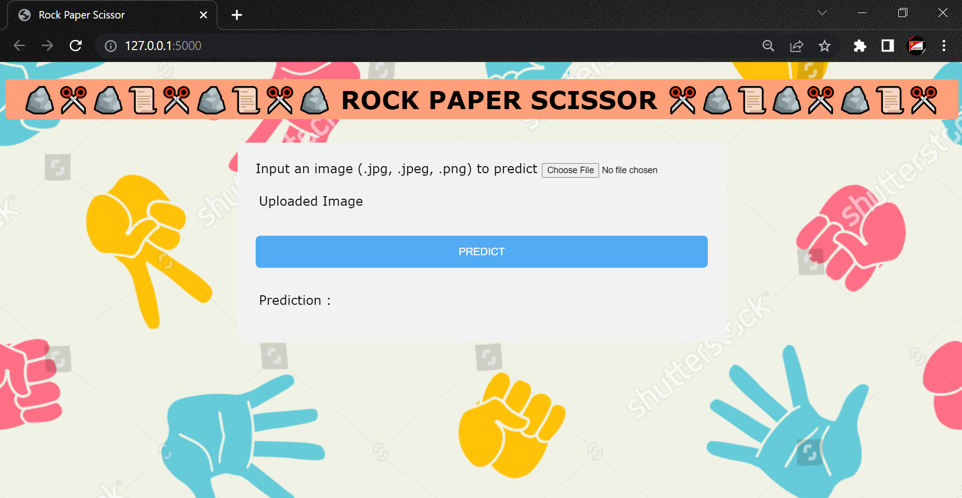
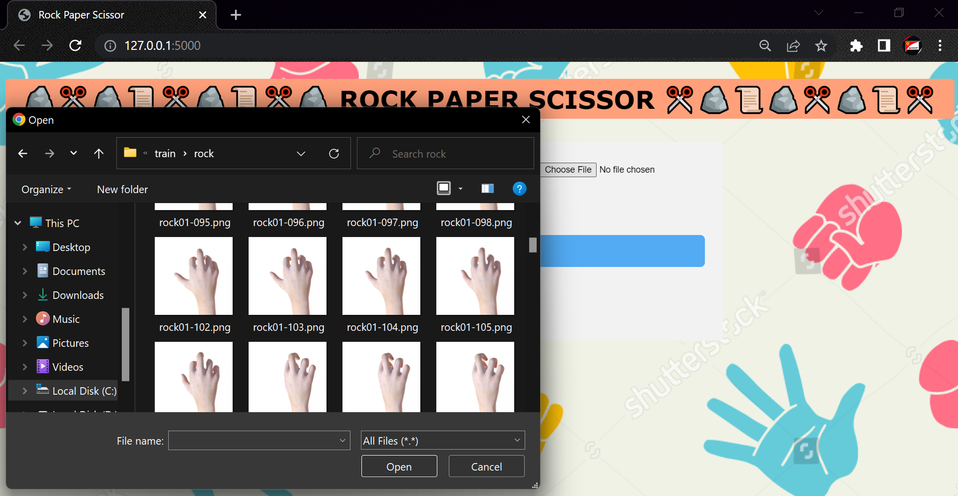
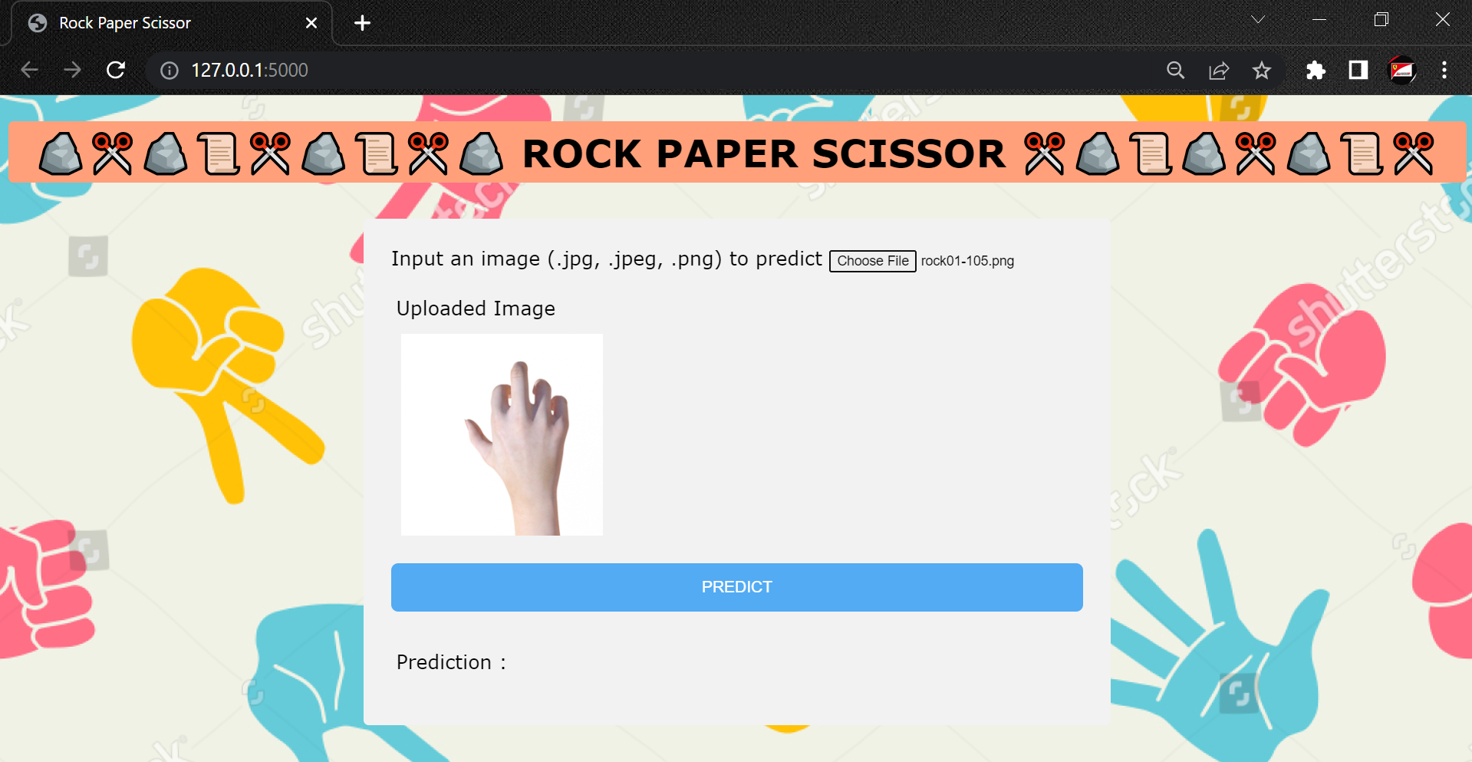

RESULTS

Slide 12
USE CASES
→We can use this model in weapons detection.
→ In medical field we can use this model for detecting patients by using X-rays.
→ We can use this model in earthquake prediction graph images.
→

Slide 13
EXTENSION OF PROJECT
→Until now we have detected the image but we can still extend the project by predicting the probability of winning rate. Like uploading 2 images (Rock and Paper) and predicting rock wins the game.
→In our project we are taking only 1 image as input, but in the further project we will be taking 2 inputs and we will be implementing Rock/ Paper/ Scissor Game.
→If not we can implement multiplayer Rock/ Paper/ Scissor Game.
→Calculating the probability of winning.

Slide 14
CONCLUSION
→We have detected the images accurately using the neural networks.
→ This image detection model can be applied to other image prediction projects also.
→ If possible we can increase the accuracy by using custom CNN model.
→ This model can predict new input images based on the data what we have trained.
→ This project can be deployed on the local servers only due to the large size of the data.

